Slide 1
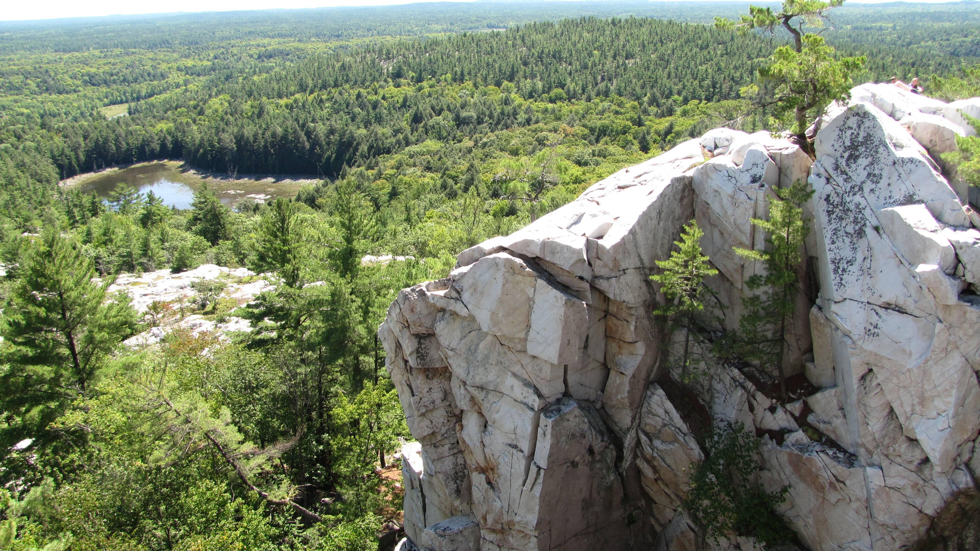
Recreation, Wildlife, and COVID-19
A 20x20 Pecha Kucha
Zachary M. Moore
December 2020

Slide 2
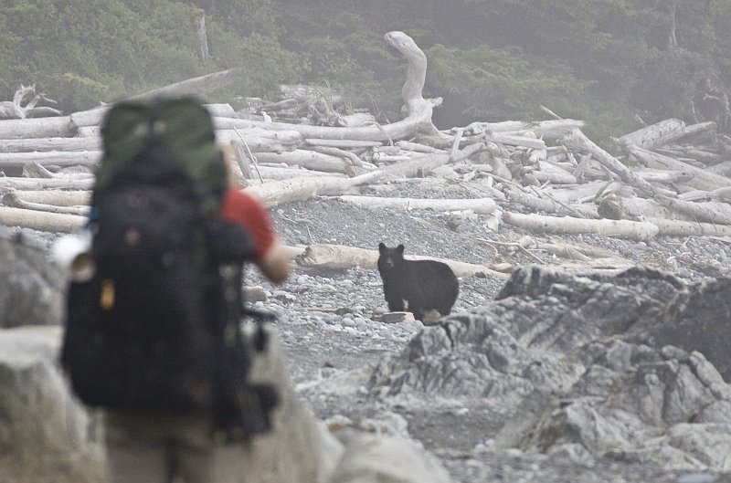

TrekNature.com
Notes:
I want to start by getting us thinking about recreation in natural spaces.
This interaction between humans and wildlife in the areas that protect the largest amount of non-human biodiversity. My stance on this subject comes from the fact that there is some data available for human usage of these places, but in reality …

Slide 3
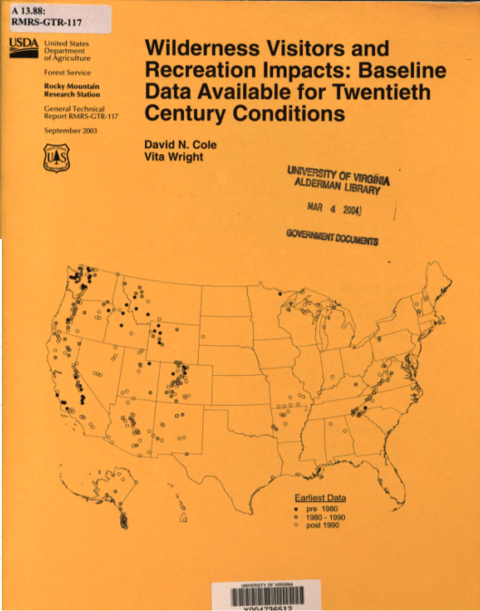
How do humans impact wildlife through recreation?
Has recreation increased because of COVID-19?
How can we measure human usage of ‘natural spaces’?
Cole and Wright, 2003
Notes:
Baselines can be hard to come by, and are only available as scattered and incomplete data for different types of human usage. In this presentation, I am going to approach this issue by answering three questions:
How do we impact wildlife with recreation?
Has our recreation increased with COVID 19, and
How can we measure recreation?

Slide 4
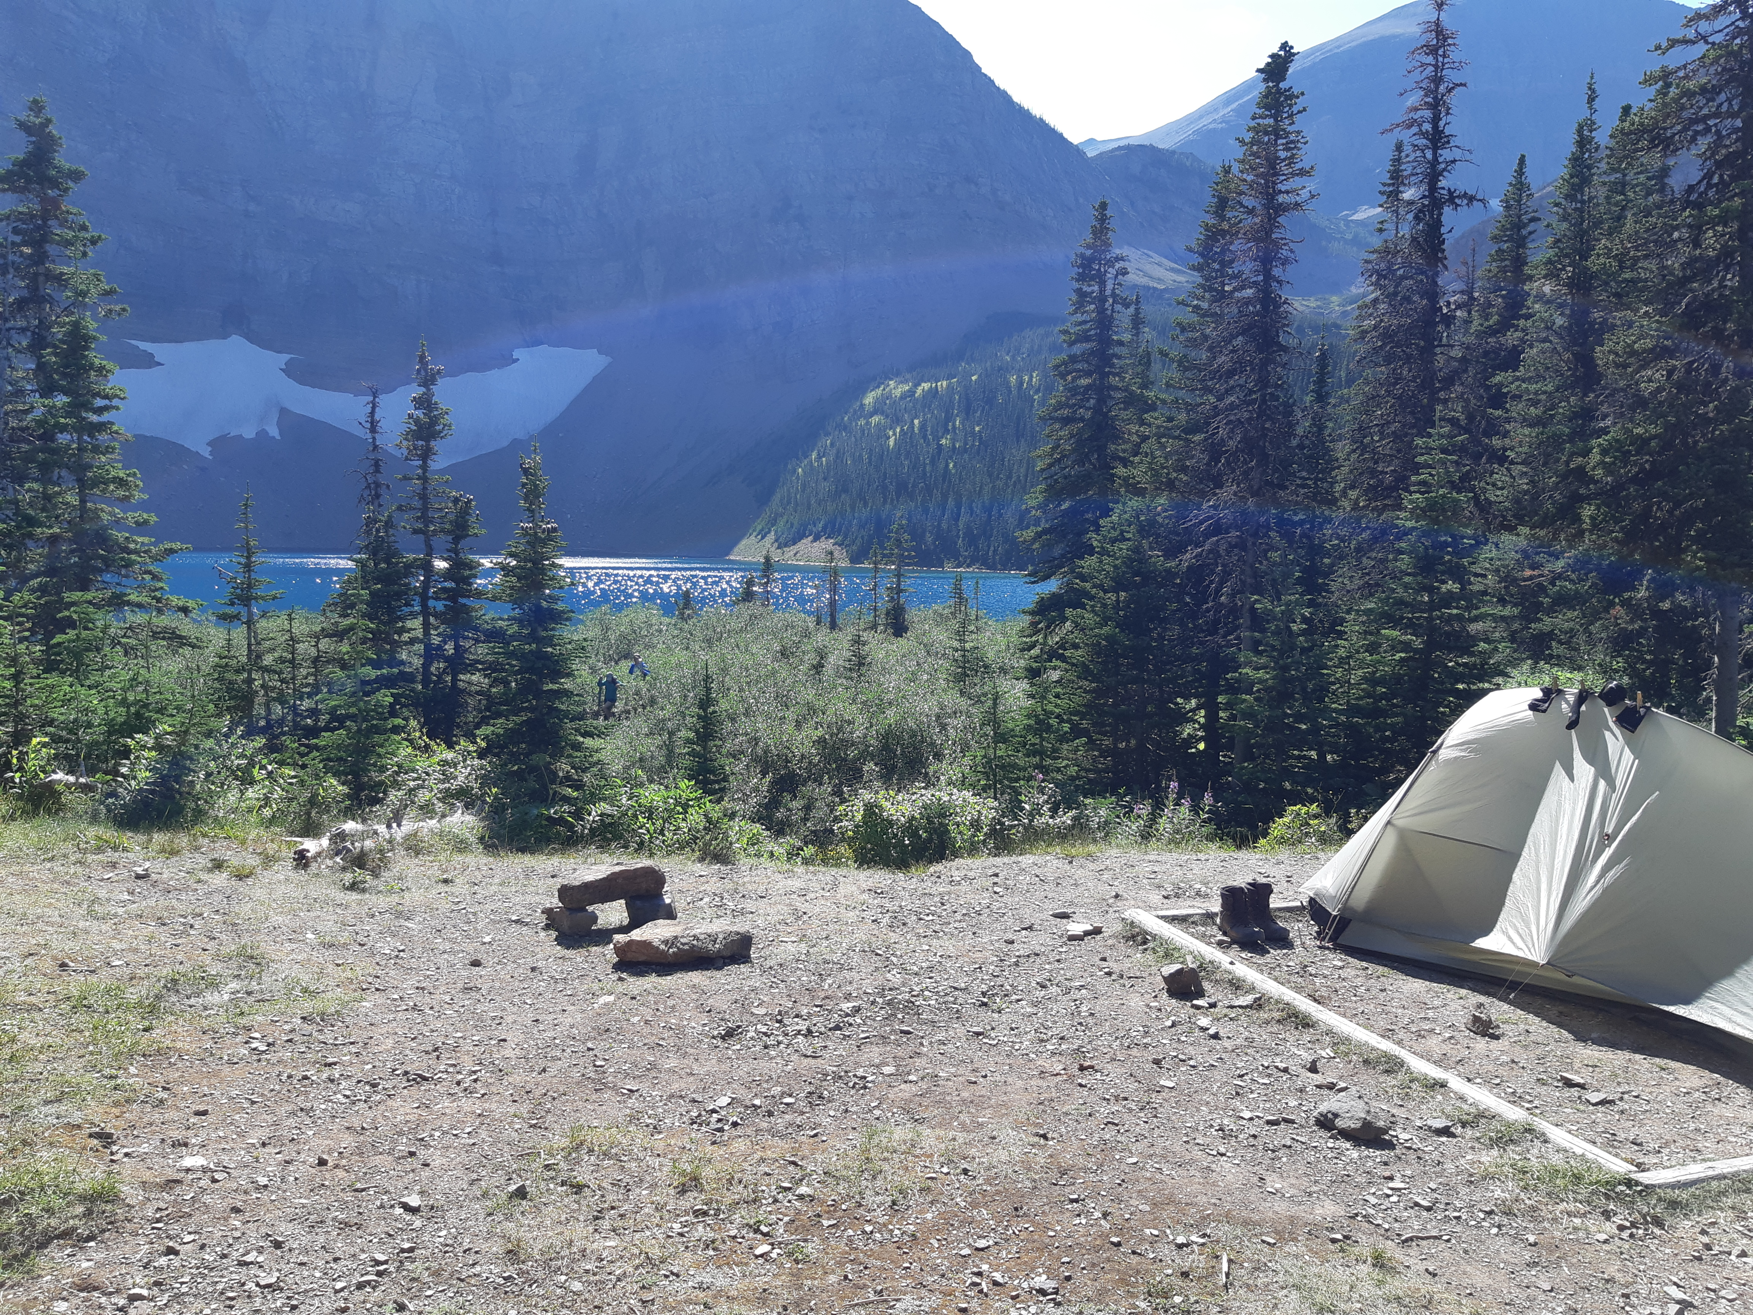
Zachary M. Moore
Notes:
When we think about the impacts of our recreation, there are obviously degrees. Let’s imagine you’re walking a well travelled trail up to some beautiful lake in the mountains to camp for the evening. Well what are the impacts of that trail? What are the impacts of the flattened campsite or the large amount of people using the lake?

Slide 5
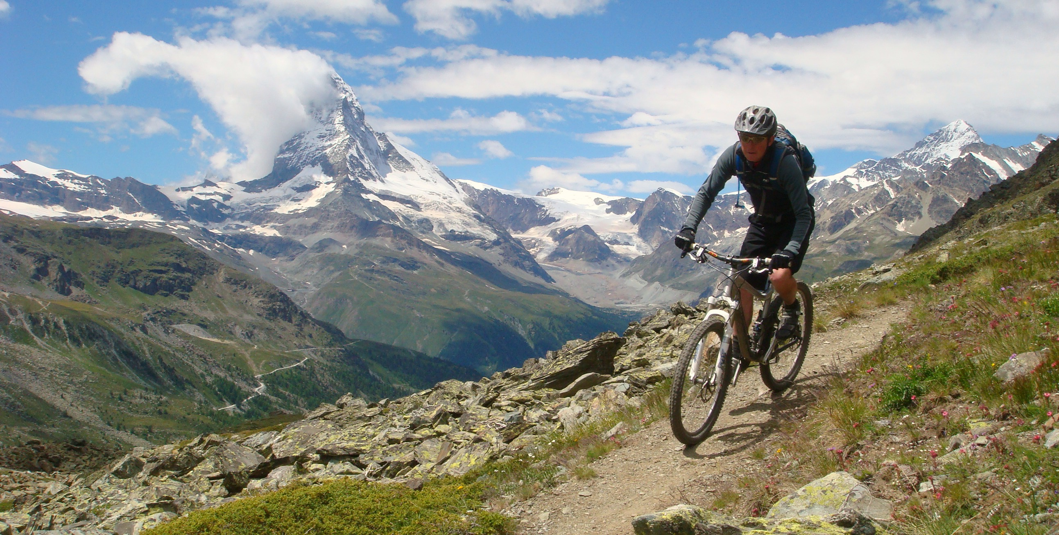
pedalMCR.org.uk
Notes:
Does walking up a hiking trail have the same impact as a mountain biker? Probably not. Mountain bike trails are wider, more compacted, and bikes are dirtier than hikers, bringing in more invasive species. They’re usually associated with more access roads for vehicles, and they’re also louder and faster, although…

Slide 6
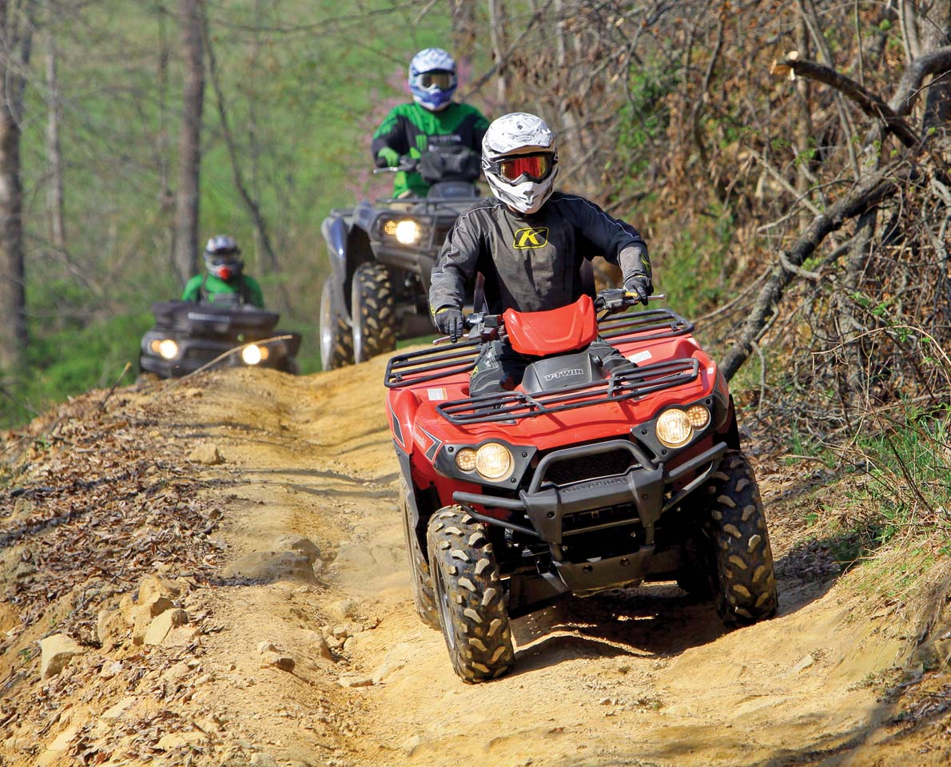
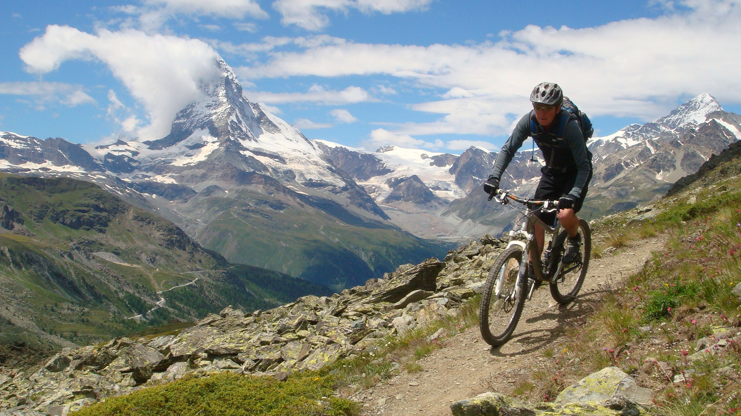
AtvIllustrated.com
Notes:
Not nearly as loud or as fast as an ATV. So now, we can think - what might the relative effects of each be? Well linear disturbances are pretty well studied in road ecology. They break up habitat, they change microclimatic conditions, and they let invasive species move in. All of these effects can be pretty negative from an ecosystem standpoint

Slide 7
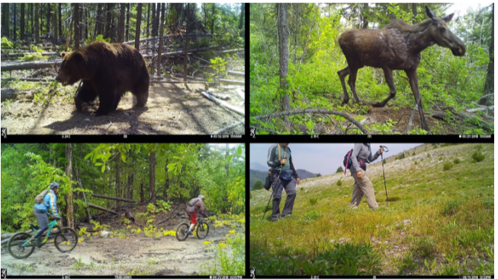
Naidoo and Burton, 2020
Notes:
But also, within these natural spaces, a recent study in BC used camera traps to show that all 13 of the mammal species they studied avoided humans on trails, and that this effect was more pronounced with mountain bikers and atv’ers than hikers. So based on these considerations like this, we can infer that the density of people using protected areas matters for wildlife.

Slide 8



Notes:
Instead of using trail cameras to track people in wilderness areas, I think we can use current technologies to get an idea of what people are thinking and use this to make observations about how human interactions with wildlife are changing. I think we can use big-data to get baselines about what people are doing in natural spaces, and then infer potential wildlife impacts.

Slide 9
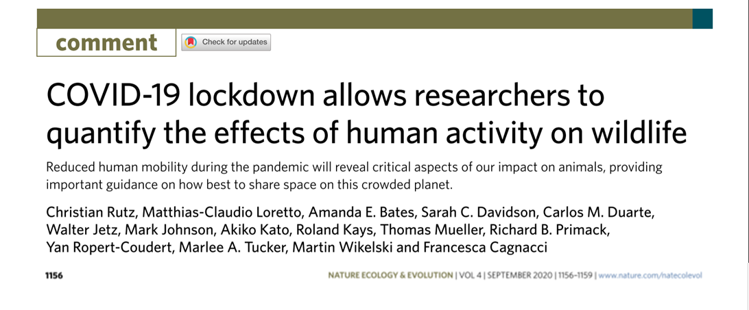
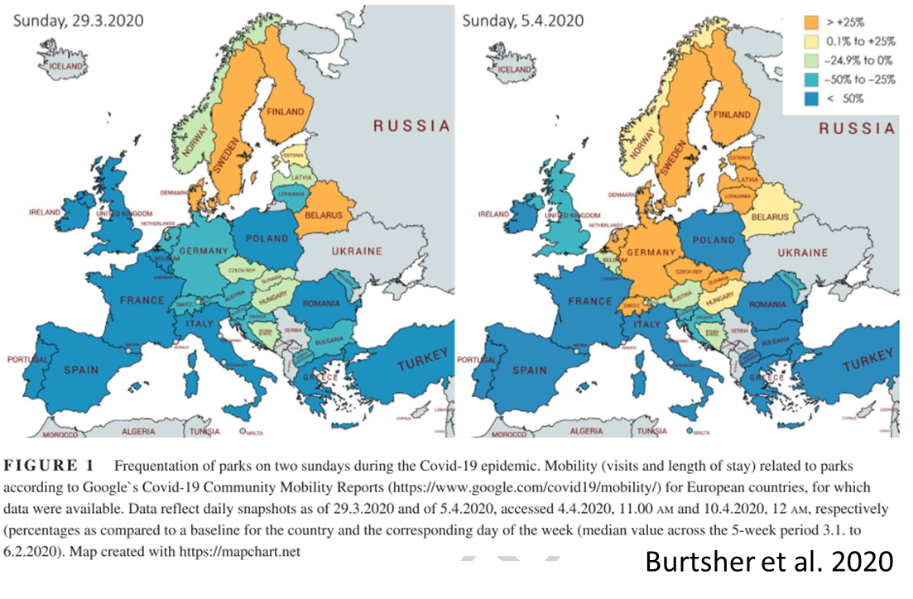
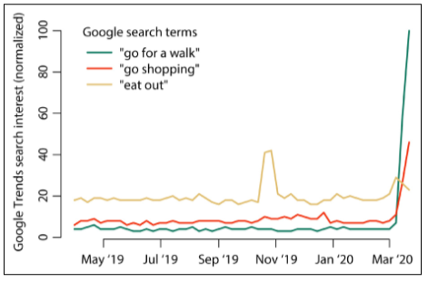
Rutz et al. 2020
Kleinschroth and Kowarik, 2020
Notes:
This isn’t an entirely novel concept, several studies have come out looking at how, during COVID, we can use different data to examine changes in human behaviour. Google specifically offers some interesting tools. They use anonymous locational data in their community mobility reports to examine how peoples movements have changed relative to before COVID.

Slide 10
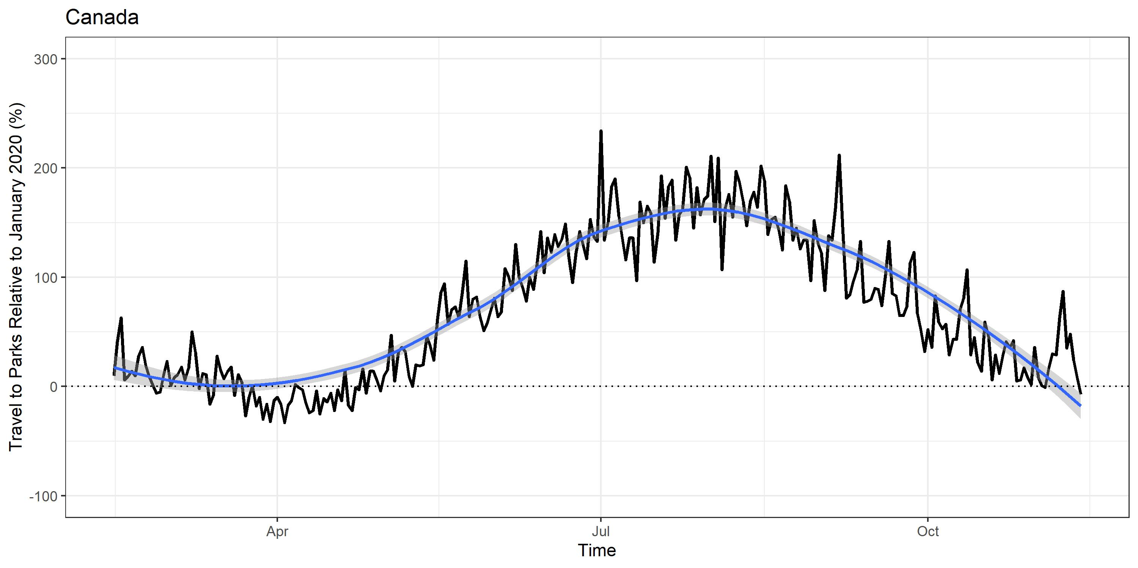
Google COVID-19 Community Mobility Reports
Notes:
So if we look at this data for Parks in Canada, you see this large spike in travel to parks throughout Canada relative to before COVID. Now ‘Parks’, by Google’s definition, includes a multitude of green spaces including urban greenspaces, national parks, camping areas, and marinas. But what about if we zoom in a little?

Slide 11
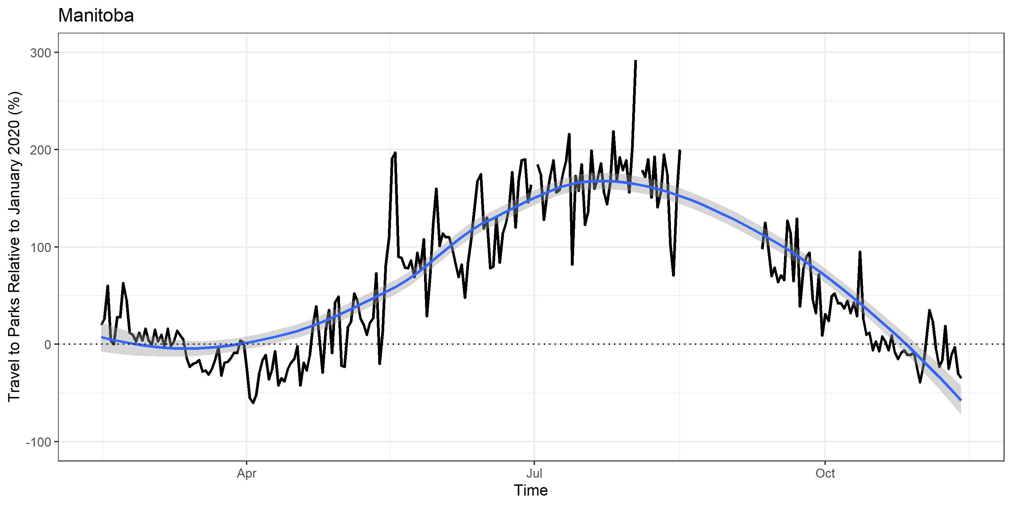
Google COVID-19 Community Mobility Reports
Notes:
When we look at Manitoba, we can see that this same trend of a nearly 200% increase in frequentation of parks is evident at the provincial level, and then it falls back down again moving into winter. But within this province, there are obviously a huge variance in types of parks or activities, so we need to zoom in a little more.

Slide 12
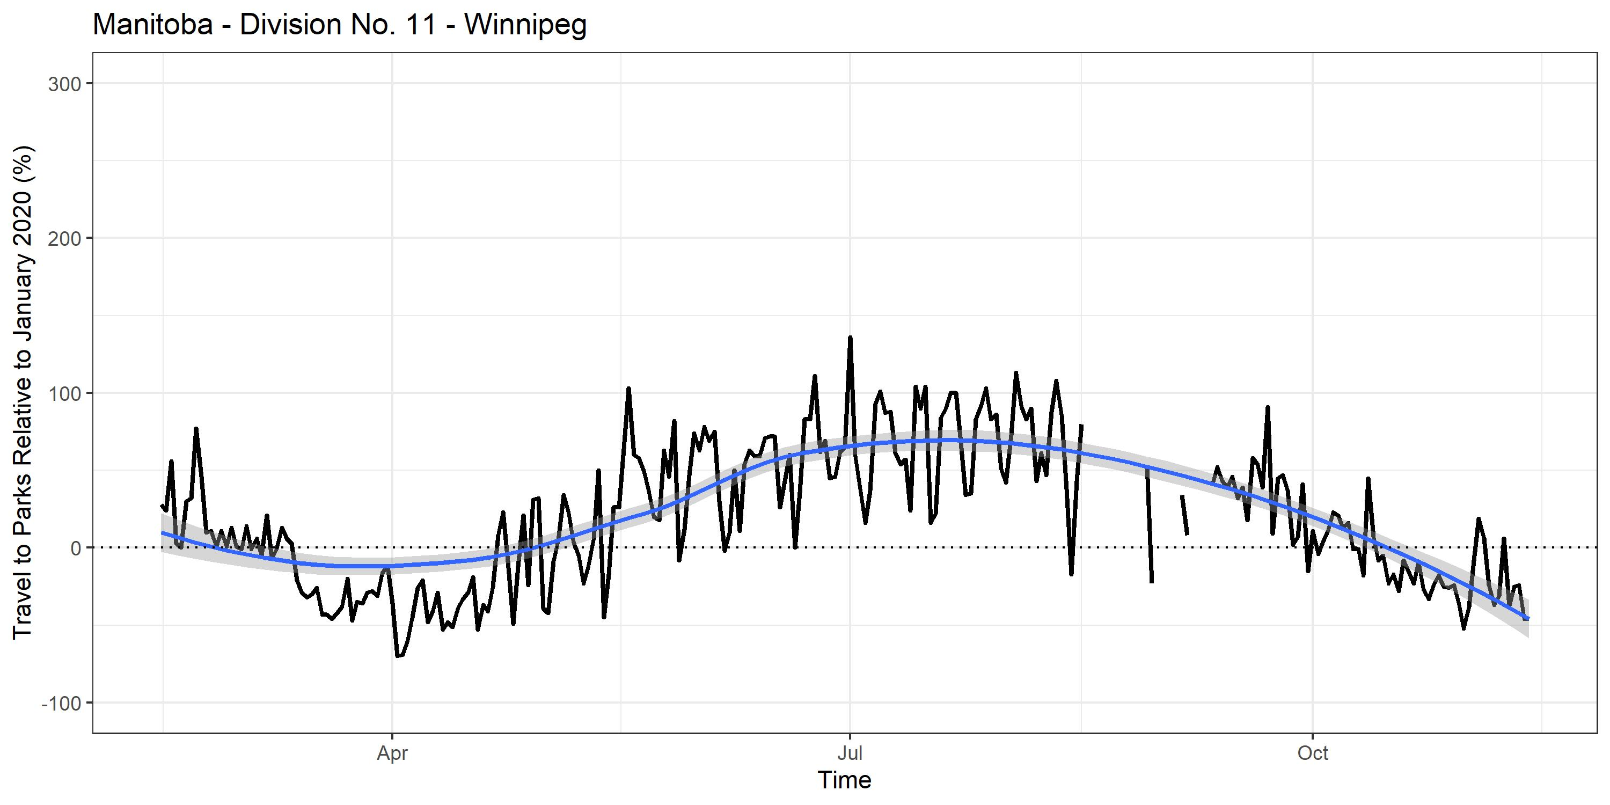
Google COVID-19 Community Mobility Reports
Notes:
In Winnipeg, we can see the increase is lower relative to the rest of Manitoba. That means it might be people OUTSIDE of the big city increasing their travel rates to parks. So if you’re still following along here, you might say, well Zack, of course people are going out to parks more in the summer. How can we tell if this is because of COVID?

Slide 13
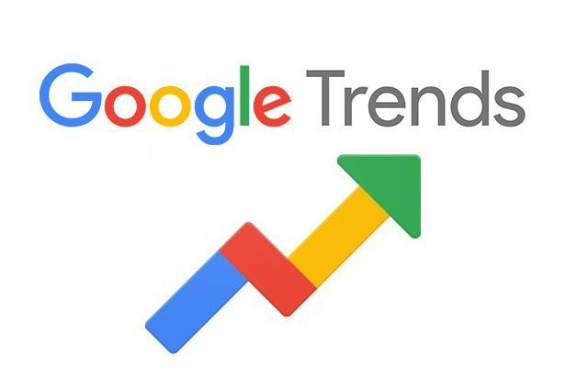
Notes:
And to that I respond, by looking at your search histories. Google trends shows us the relative interest in any search topic we want within timelines exceeding 5 years. It shows the point in the time period with the highest interest as 100, and every other time relative to that most popular period. And with that, we can ask questions like…

Slide 14
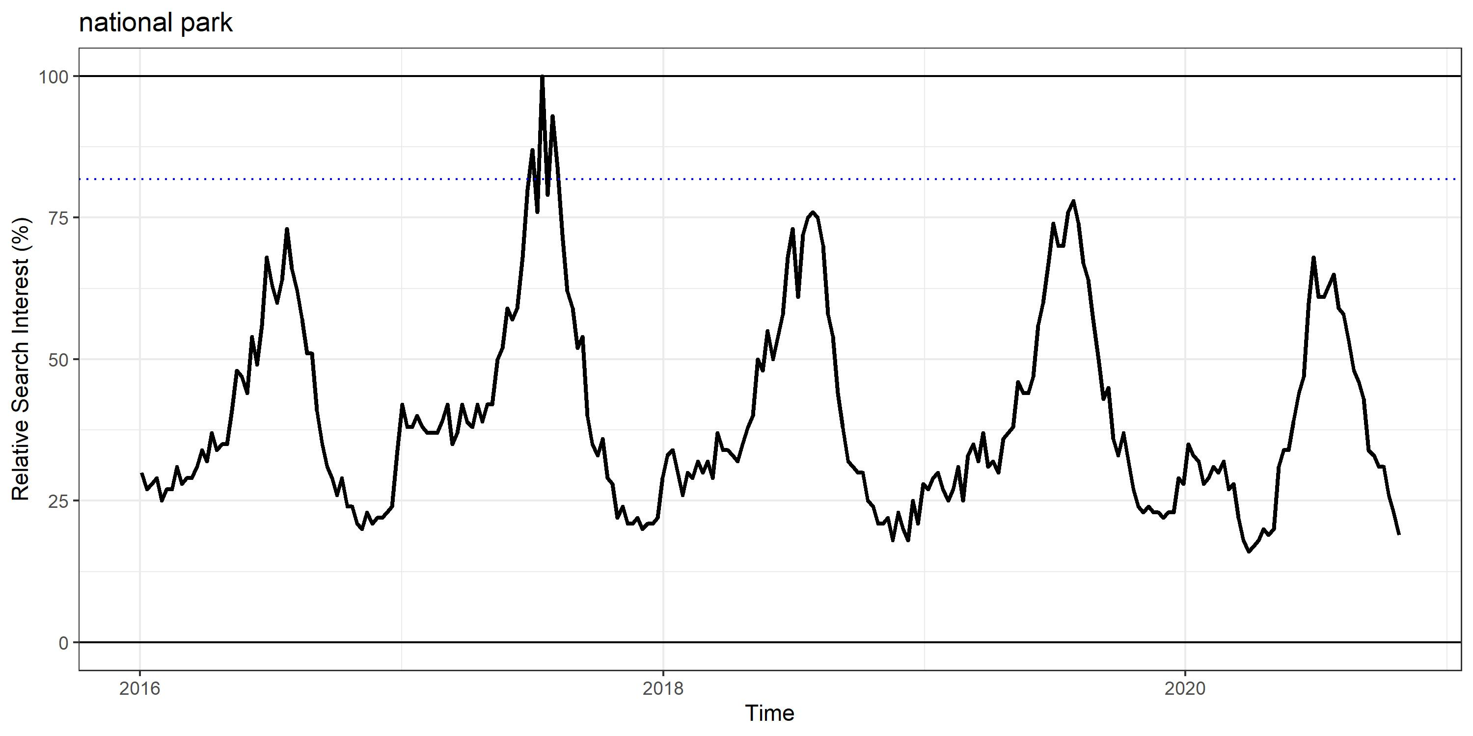
Where are people going?
Google Trends Data
Notes:
And with that, we can ask questions like “Where are people going?” In Canada, over the last 5 years, searches for national park are pretty cyclic, starting in the early spring and tapering off in the fall. You can see that the highest searches for national park were in 2017 during the Canada 150 free access promotion, and that this year, with COVID, there’s been no real increase in interest.

Slide 15
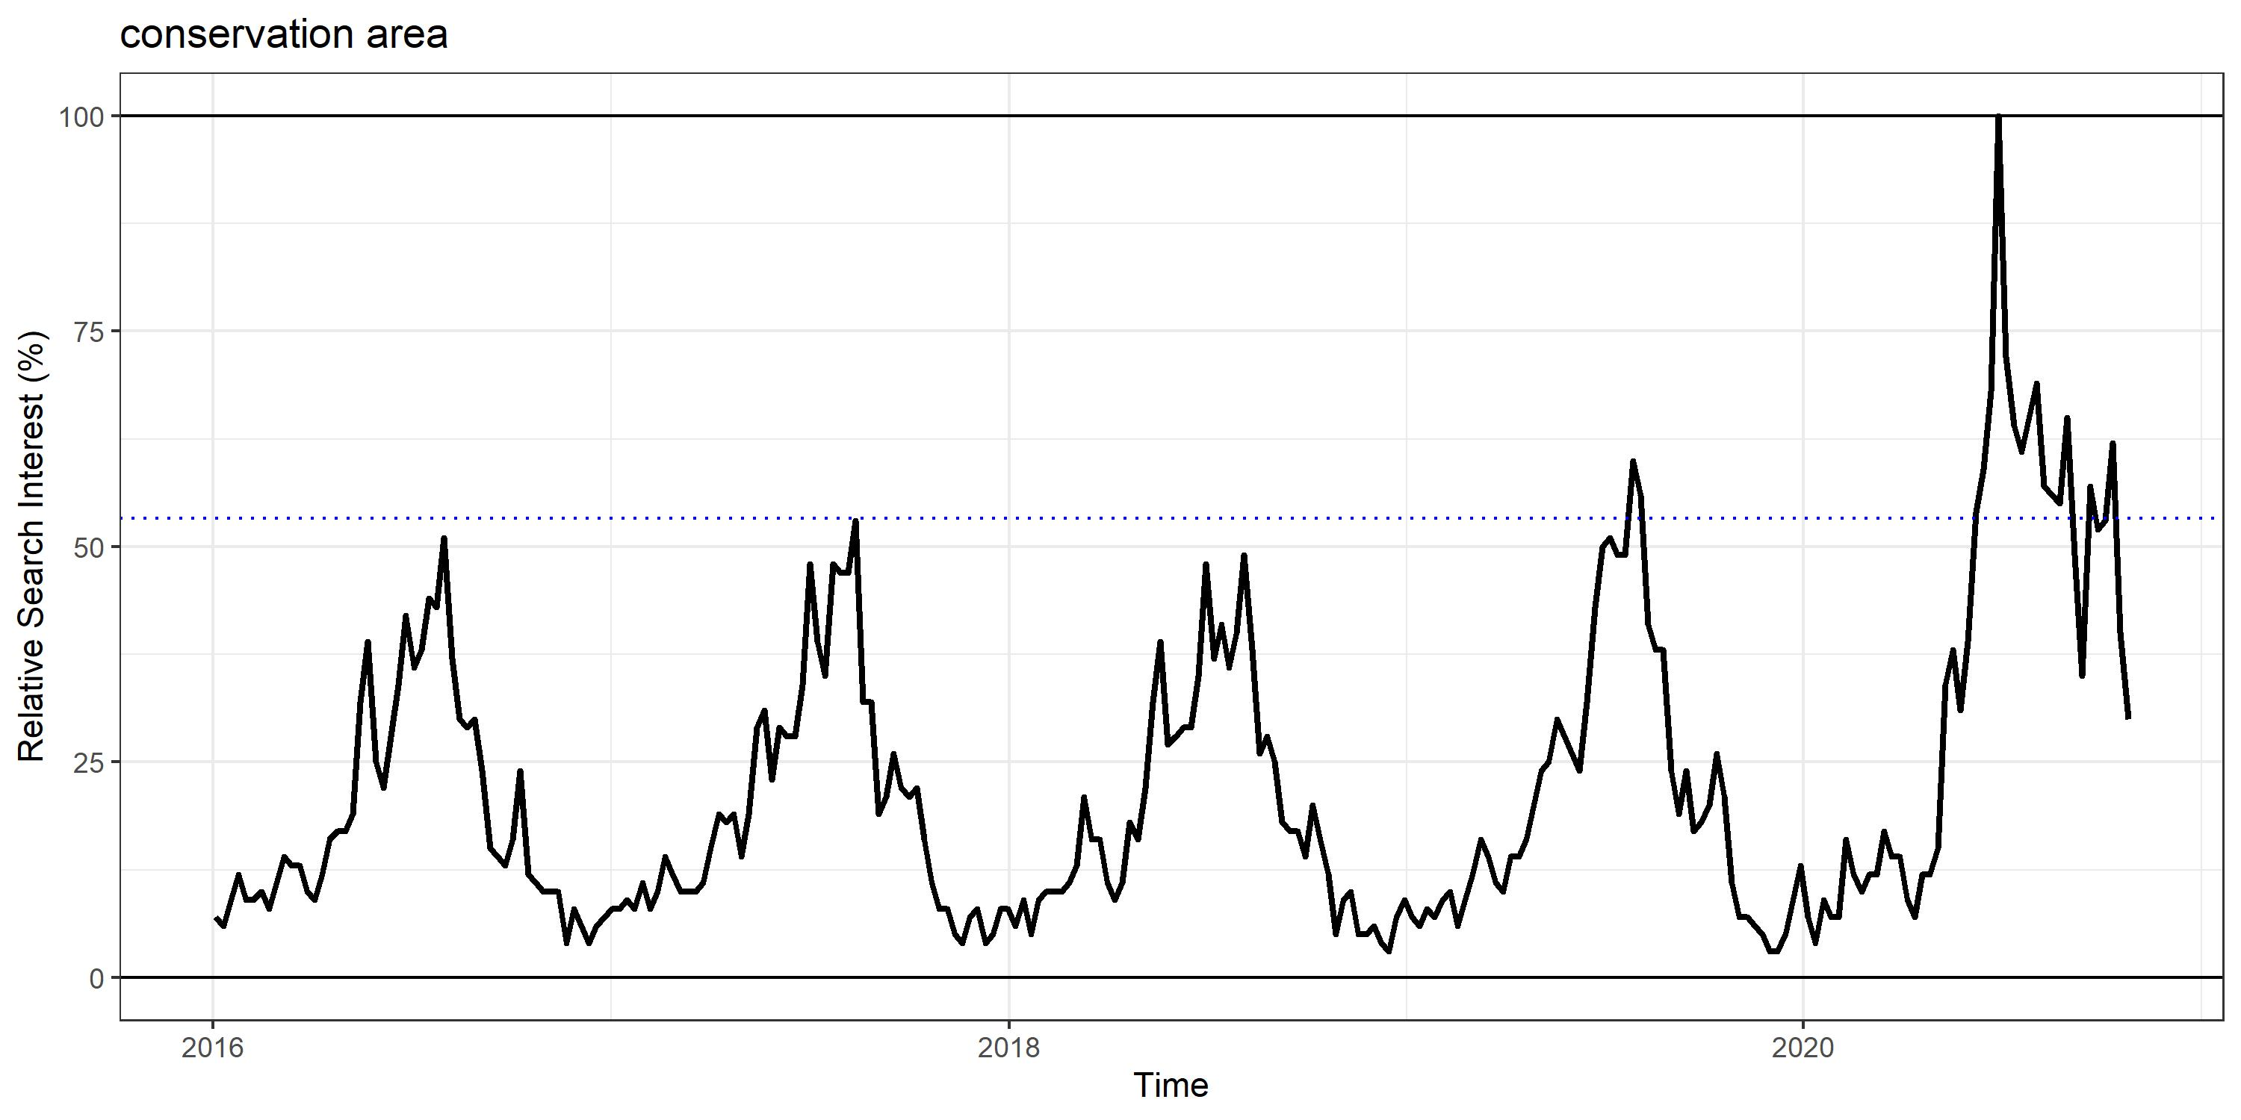
Where are people going?
Google Trends Data
Notes:
But, if we look at something like “conservation area” we see a huge spike this year in COVID relative to the 4 year maximum interest, which is shown here as the dotted line. So Maybe people aren’t looking into going to national parks as much as they’re looking into places they haven’t been before, like conservation areas or…

Slide 16
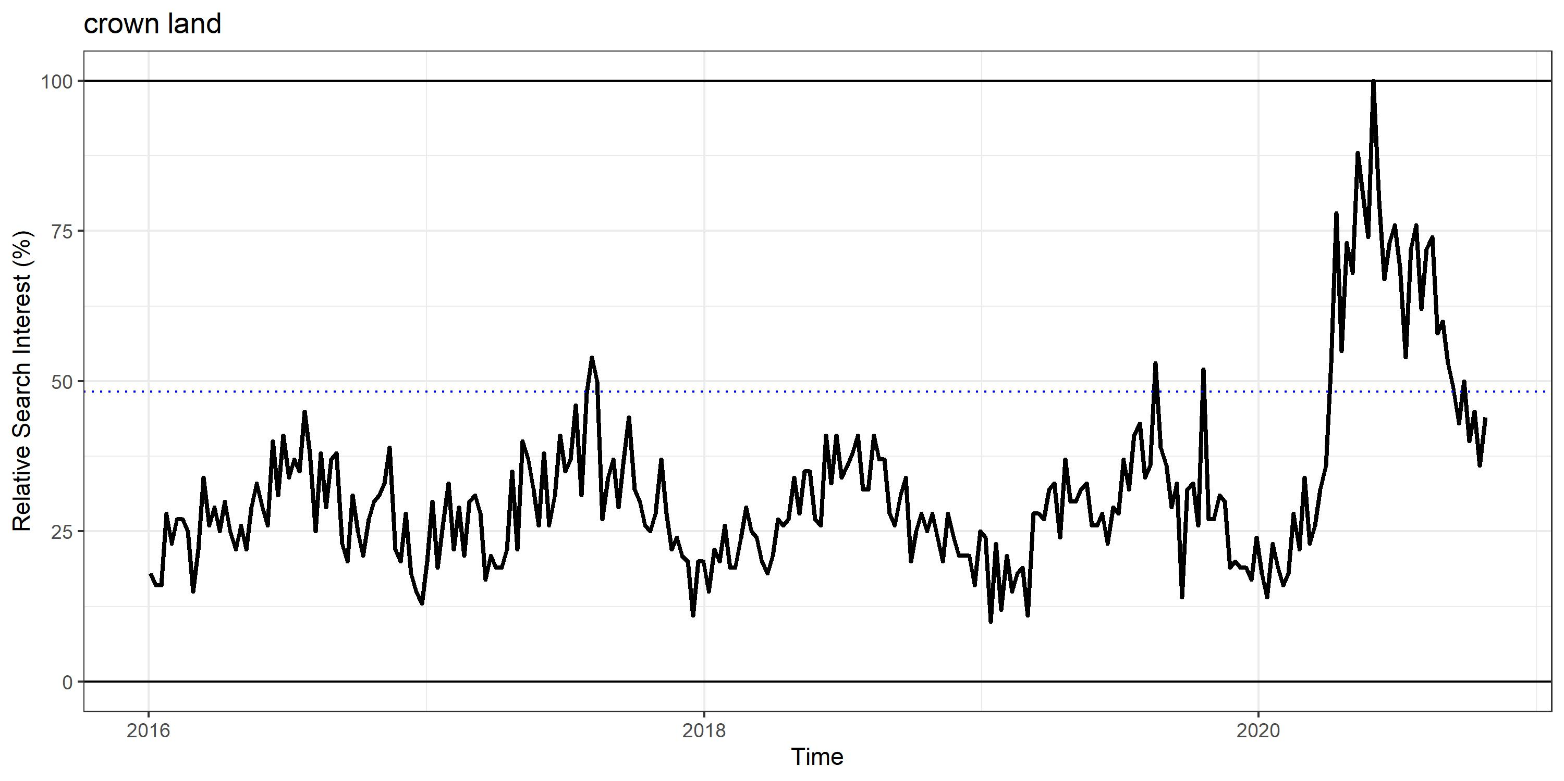
Where are people going?
Google Trends Data
Notes:
Crown land. Crown land, especially in the Rocky Mountain region of Canada, is a huge area for recreation. However, it has some differences from traditional parks in that it is mostly unmonitored, and has few regulations for recreation. So if people during COVID are travelling away from our national parks and to more unregulated areas, we can ask…

Slide 17
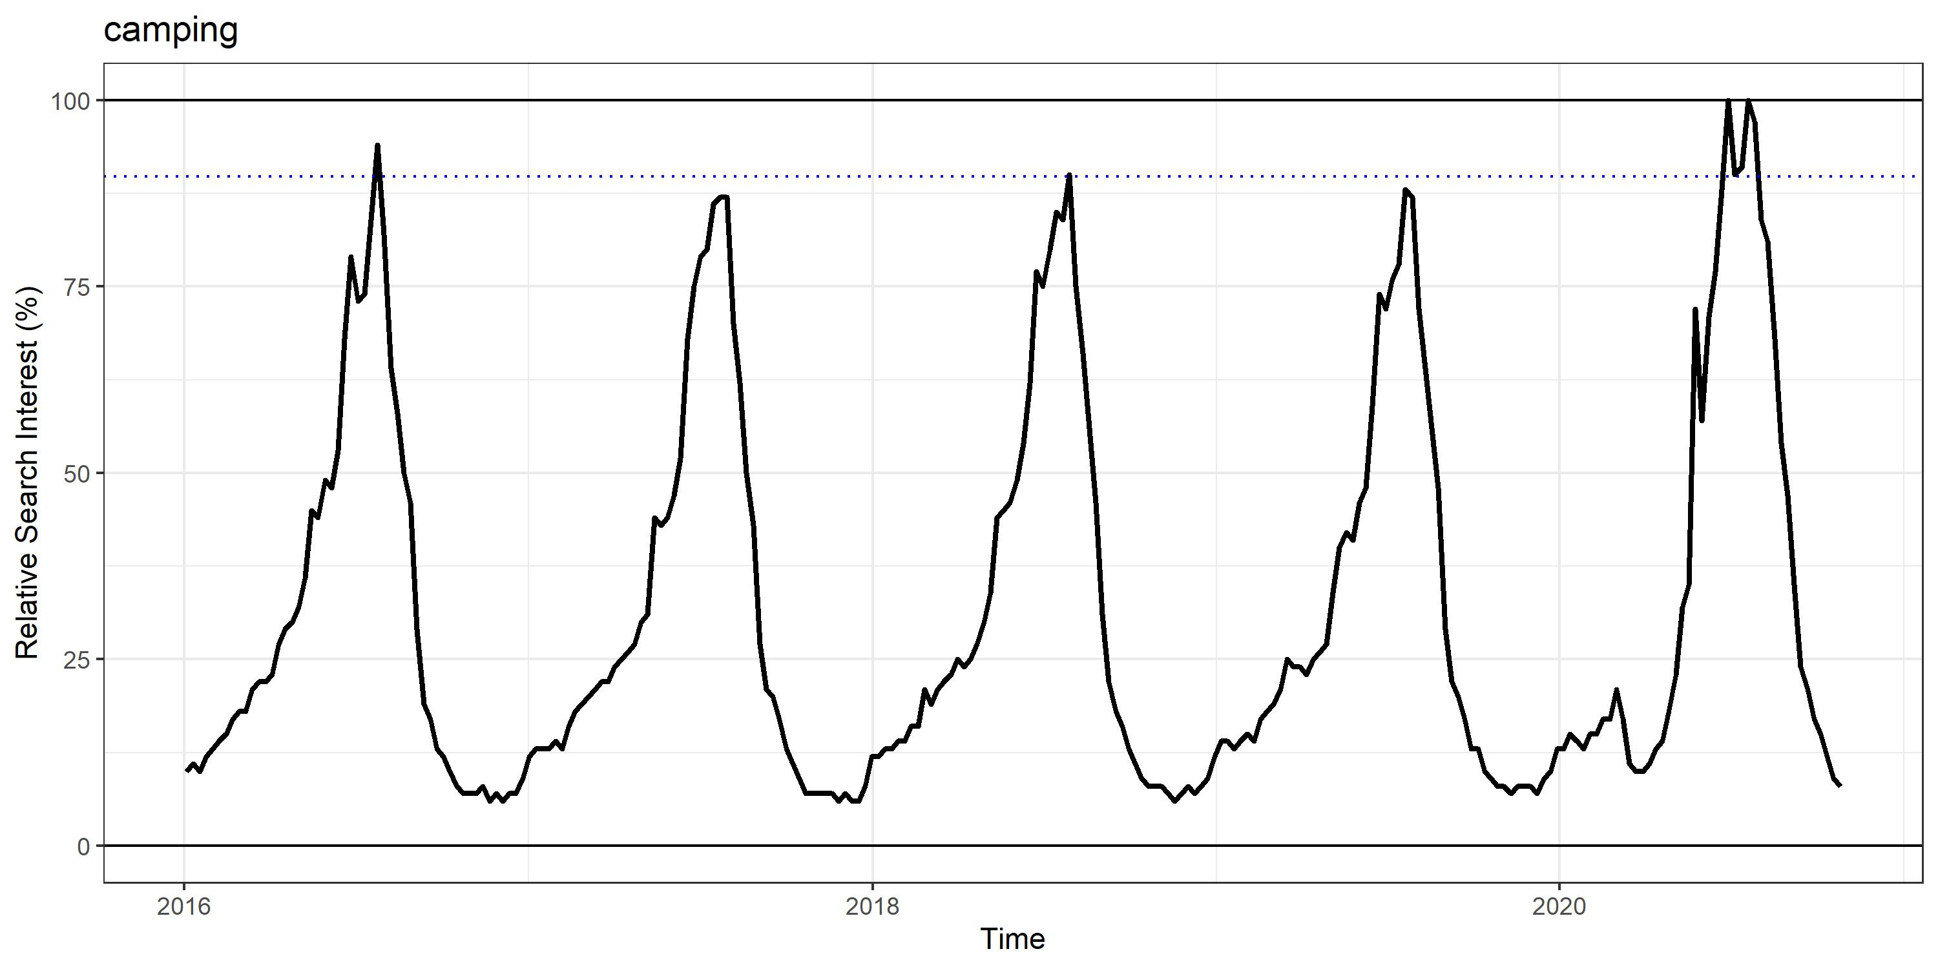
What are people doing?
Google Trends Data
Notes:
WHAT ARE THEY DOING
Well if we look up the term “Camping”, we see a moderate increase in interest in camping in 2020 relative to the past 4 years, Camping has a moderate impact in the creation of high-traffic trails and other issues, but as we saw in that BC trail camera study I mentioned, the impacts of trail users are not nearly as significant as …

Slide 18
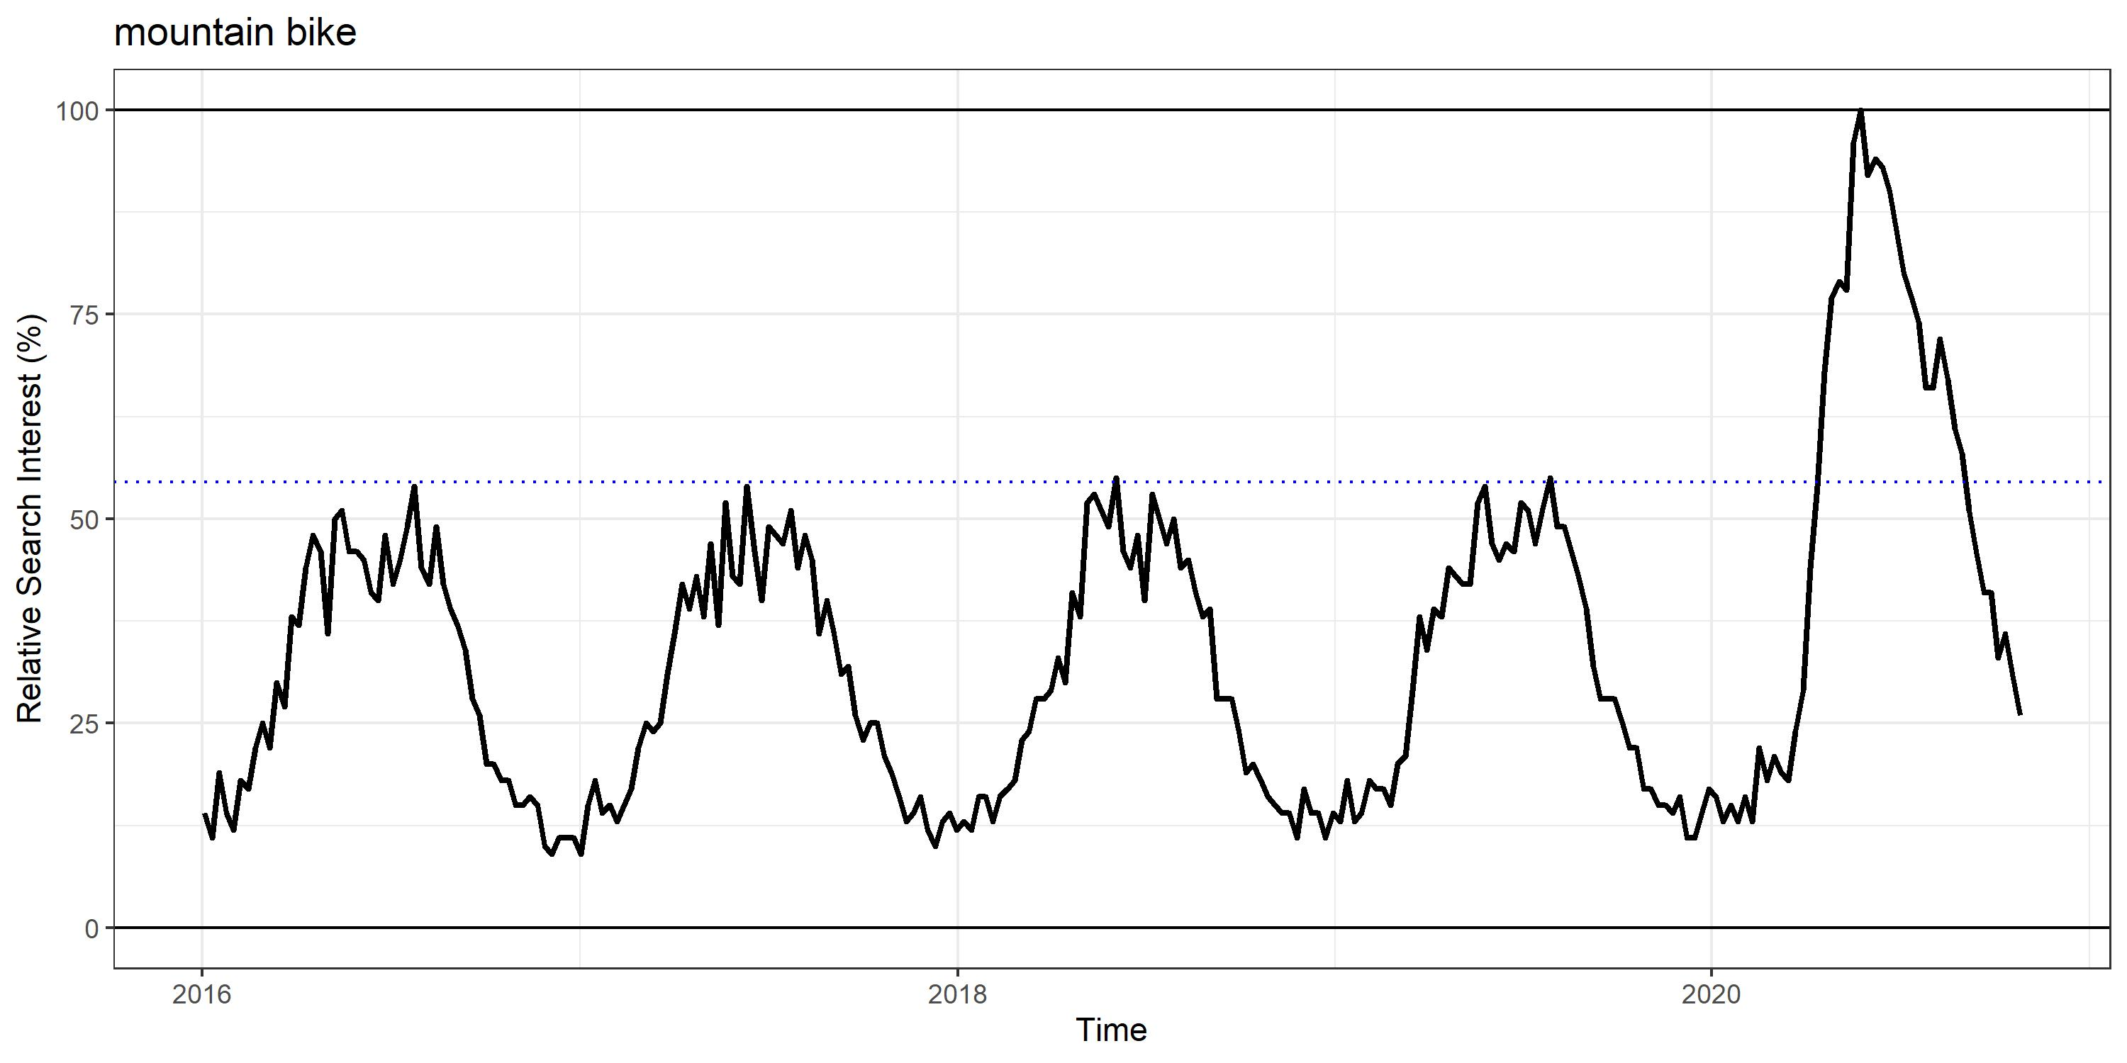
What are people doing?
Google Trends Data
Notes:
Mountain bikers. Which has seen interest spike through the roof. Searches for ‘mountain bike’ were nearly twice as popular in 2020 compared with the previous 4 years. Now, am I trying to say that mountain biking is bad? No – Not entirely. I think it’s great that people are going outside and using these spaces to truly enjoy the areas that we are protecting.

Slide 19
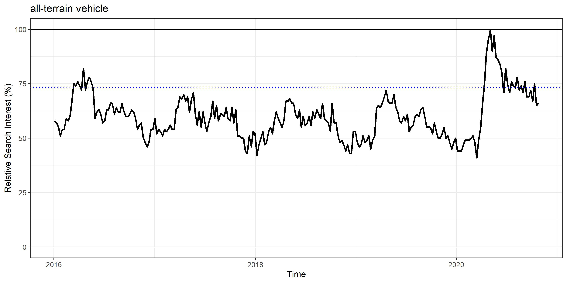
What are people doing?
Google Trends Data
Notes:
BUT I am trying to say that we should use the technologies at our disposal to monitor how interest in recreation activities like mountain bikes, or ATV’s has changed given COVID, and think about how this might impact wildlife. Now, all of the graphs I’ve shown for trends have been for interest at the Canadian level, but…

Slide 20
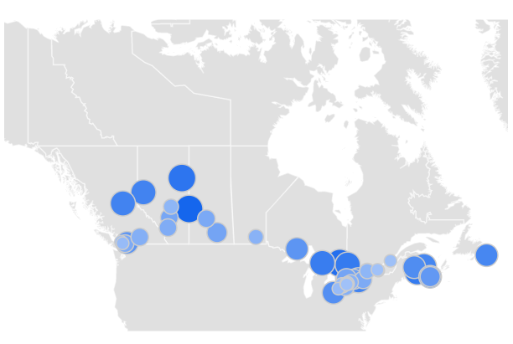
Where are people doing what?
Google Trends Data
Notes:
What this data allows us to do is zoom in on certain areas and examine how human interactions with our wild spaces are changing, and postulate on how this will impact that wildlife that we are also trying to protect in these areas. This could be a really effective management tool to establish baselines around our recreation in natural spaces.

Slide 21
TrekNature.com
Notes:
And by using this data to examine where human impact is increasing and what it is they’re doing, we can pair it with information we are collecting on sensitive wildlife populations to make sure that our enjoyment of these spaces does not equate to the alienation or the eradication of the wildlife with which we share these amazing areas.
Thank you.

Slide 22
Literature
Burtscher, J., Burtscher, M., & Millet, G. P. (2020). (Indoor) isolation, stress, and physical inactivity: Vicious circles accelerated by COVID‐19? Scandinavian Journal of Medicine & Science in Sports, 30(8), 1544–1545. https://doi.org/10.1111/sms.13706
Cole, D. N., & Wright, V. (2003). Wilderness visitors and recreation impacts: Baseline data available for twentieth century conditions (RMRS-GTR-117; p. RMRS-GTR-117). U.S. Department of Agriculture, Forest Service, Rocky Mountain Research Station. https://doi.org/10.2737/RMRS-GTR-117
Kleinschroth, F., & Kowarik, I. (2020). COVID-19 crisis demonstrates the urgent need for urban greenspaces. Frontiers in Ecology and the Environment, 18(6), 318–319. https://doi.org/10.1002/fee.2230
Naidoo, R., & Burton, A. C. (2020). Relative effects of recreational activities on a temperate terrestrial wildlife assemblage. Conservation Science and Practice, 2(10), e271. https://doi.org/10.1111/csp2.271
Rutz, C., Loretto, et al. (2020). COVID-19 lockdown allows researchers to quantify the effects of human activity on wildlife. Nature Ecology & Evolution, 4(9), 1156–1159. https://doi.org/10.1038/s41559-020-1237-z
Data
Google COVID-19 Community Mobility Reports. Accessed November 15th, 2020. https://www.google.com/covid19/mobility/
Google Trends. Accessed November 15th, 2020. https://google.com/trends/
R Core Team. (2018). R: A language and environment for statistical computing. R Foundation for Statistical Computing. https://www.R-project.org/
Wickham, H. (2016). ggplot2: Elegant Graphics for Data Analysis. R Foundation for Statistical Computing. https://www.R-project.org/
Photos
Campsite - Zachary M. Moore
Mountain Biker - pedalMCR.org.uk
ATV Rider - AtvIllustrated.com
Backpacker and Bear - TrekNature.com
Google Logos - www.google.com

